Slide 1
Transition to Alumnae
Date
Presented by:

Slide 2
WELCOME
Notes:
Welcome to the alumna education meeting. We’re so glad to have you here. Throughout their lives, Kappas demonstrate bonds of sisterhood and mutual support, sustaining members in bad times, celebrating in good times, and sharing at all times. We are always Kappas. Today, we’ll focus on understanding some of the benefits and responsibilities of alumna membership. Regardless of your membership status, we always remain true to the promises and vows we made during our Initiation.

Slide 3
Benefits & Responsibilities of Alumna Membership
01.
Ways to Stay Connected
02.
AGENDA
03.
Letters “To Myself..”
04.
Service for Graduating Seniors
Notes:
Today, we’ll go over the following.
Benefits and opportunities of alumna membership.
Open the “To Myself as a Senior” letter from your new member guide.
Write the “To Myself as a 25-Year Alumna” letter from your new member guide.
Conduct the Service for Graduating Seniors.
We’re so excited for you and this next step in your Kappa journey. We want to introduce you to the benefits and opportunities you will have as alumnae.

Slide 4
BENEFITS & RESPONSIBILITIES OF ALUMNA MEMBERSHIP:
A CLOSER LOOK
Notes:
As an alumna, we hope that you will continue to be actively involved with the Fraternity. There are so many ways in which you can remain involved and continue to make an impact on the Fraternity and your community. Alumna life has many rewards from networking with other Kappas, making new friends, participating in philanthropic activities and working with a chapter are just a few of the benefits of a lifetime membership in our Fraternity. Let’s take a minute to review the many ways you can stay involved and continue your active support with Kappa.

Slide 5
ALUMNAE LIFE IS REWARDING
Networking
Friendship
  Continued from collegiate years and new ones, too!
Receive Support from the Foundation
Philanthropic Work
Giving Back
Supporting a Chapter

Slide 6
KAPPA KAPPA GAMMA FOUNDATION
Focus areas
Heritage
Scholarships
Educational Programming
Financial Assistance
How to Support
Kapppa.org/donate
A gift of any size leaves a lasting impact on our sisterhood and ensures that we can all live boldly.
Notes:
The Kappa Kappa Gamma Foundation supports our members and heritage:
Educational and leadership programming
Museums
Rose McGill Aid For Emergency Assistance, graduate school grants and Holiday Sharing
Scholarships
Supporting the Kappa Kappa Gamma Foundation preserves our rich fraternity heritage and provides for many of the leadership and educational programs for our undergraduates and alumnae. The Foundation maintains our museums, provides emergency financial assistance for both undergraduate and alumnae members, as well as provides undergraduate and graduate scholarships.

Slide 7
KAPPA KAPPA GAMMA FOUNDATION
Receive support after graduation:
Graduate & Continuing Education Scholarships
Talk Space
Rose McGill Aid
Over 200 online courses on Kappa Edge
Attend Leadership Academy
Career Academy
And so much more!
Notes:
Talkspace, an online platform, makes it convenient to access mental health resources and paves the way for accessible mental health care. All alumnae receive a 25% discount to utilize Talkspace as a resource. This is just one of many benefits of alumna membership.

Slide 8
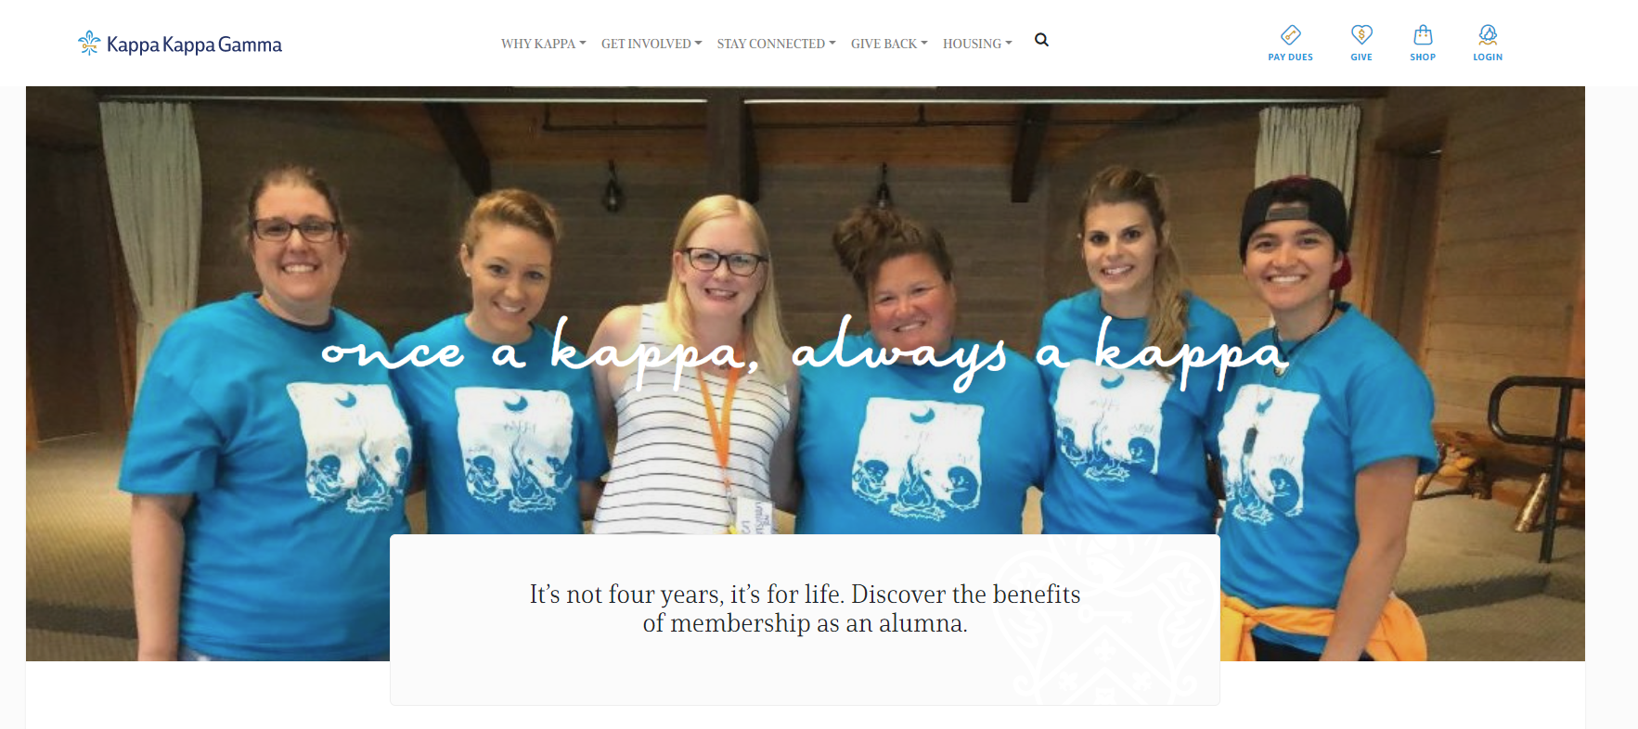
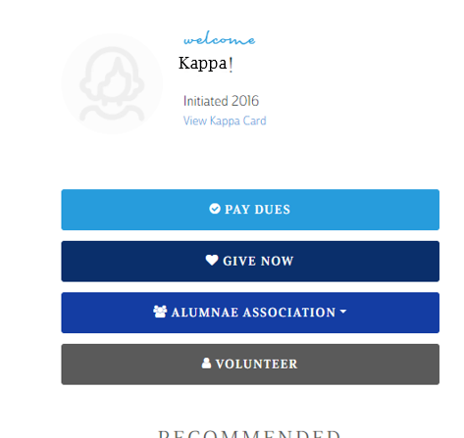
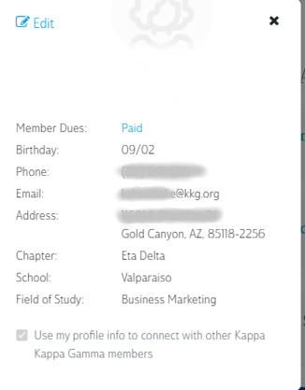
STAY CONNECTED: UPDATE YOUR CONTACT INFORMATION
Kappa.org
Notes:
We cannot emphasize enough the importance of staying connected with the Fraternity. One of your first priorities will be to keep the Fraternity updated with your current address and contact information. You can update your information either through the Kappa website.
Many graduating alumnae forget to change their contact information upon graduation and we lose connection with them to tell them about events, volunteer opportunities, or ways to stay connected to their initiating chapter. Before you graduate, update your email to a non-school address to ensure you can still hear from Kappa as an alumnae!
Explain the importance of updating their contact information every time they move.
Demonstrate how to edit their member profile.
Explain that updating their profile is the only way sisters searching for them can find their most recent address and reach out. It’s also the only way the Fraternity can update them about events and opportunities in their area as well as send them The Key.
If possible, have laptops, tablets, and other smart devices set up at the event to allow senior members to update their profiles with their new information (e.g., non-university email address or new home address). This is very important to ensure that we can keep in touch with our graduates. Please assure members that all Kappa members have the ability to set their communication preferences.

Slide 9
MORE WAYS TO STAY CONNECTED
Volunteering – immediate opportunities available
  With a chapter, district-level, & program-specific
Attending events like Leadership Academy & Convention
Paying Alumnae dues
Joining an Alumnae Association
  Events and volunteering opportunities
Join a Special Interest Group
Notes:
Volunteer
Supporting a local chapter is another rewarding way of staying involved and helping to mentor our future Kappa leaders. Involvement can be small or large and there are many opportunities from writing a reference form for a potential new member, becoming an adviser or house board member, lending a hand with Recruitment or Initiation, or supporting a chapter’s philanthropy.
Attend Events
You can attend our Biennial Convention held every other year (even years). Leadership Academy, which is funded through a generous grant from the Kappa Foundation is also open to alumnae. We are proud that education and leadership opportunities for our members don’t stop at graduation but continue throughout our lives.
Information about these events can be found on the Kappa website or emailed to alumnae as event registration approaches.
Paying Dues
Pay your annual per capita fee. (Current annual dues amount is $27 for new alumnae)
Per Capita fee amounts for the 2023–24 fiscal year, effective July 1, 2023 will be as follows:
Alumna members: $37
Alumna members within eight years of their initiation date (excluding alumna initiates) or members who have reached their 65-year member milestone: $27
If you will not be joining an alumnae association, you can pay your using the Dues Direct option through Kappa Headquarters. This can be done through:
The Kappa website
The form in The Key
Per capita fees are the annual alumna dues, which are $27.
1. To be considered a member in good standing, your per capita fees must be paid annually. Good standing allows you to be appointed or be elected to certain Fraternity volunteer roles too.
2. Per capita fees can either be paid through your alumnae association or through our Dues Direct program which you can find on the Kappa website.
3. Per capita fees help to support educational opportunities for undergraduates and alumnae.
4. The continued growth of our chapters and alumnae associations.
5. Publication of our award-winning magazine, The Key.
6. Fraternity Headquarters operations.
7. Payment of your per capita fees ensures the future of our organization.
Joining an Alumnae Association
You will learn more about Alumnae Associations in a few minutes
Join a special interest group.
Explain the special interest groups and how these groups might be a resource and benefit to them as alumnae.
The Golden Key Alumnae Association is a group of Kappas who search for Kappa badges for sale online and purchase them to ensure the badges do not end up in the hands of nonmembers. This network of women regularly communicates via email about their progress.
The Stars and Stripes Alumnae Association provides a Kappa connection for military-affiliated alumnae no matter where they may be located. Most members are military spouses or active-duty servicewomen, but Kappas who have children or siblings in the military can join. The group meets online and functions as an information-sharing resource for alumnae stationed all over the world.

Slide 10
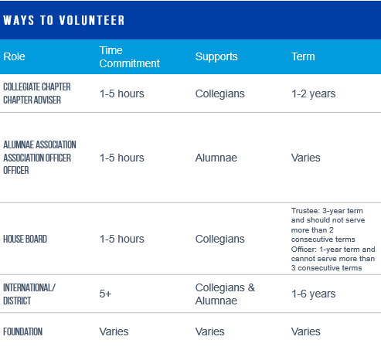
VOLUNTEER
Whether you have one hour a week or 10 hours a week, there is a volunteer role for you!
Notes:
There are many ways for alumnae to volunteer with the Fraternity – some even as soon as you graduate!
Recent graduates can begin volunteering right away as an Alumnae Association Officer or as a House Board Trustee
To volunteer, complete the volunteer interest form on the website, and you’ll be supported to find a volunteer role that aligns with your interests and skills.
There are many ways for alumnae to volunteer with the Fraternity – some even as soon as you graduate!
Recent graduates can begin volunteering right away as an Alumnae Association Officer or as a House Board Trustee
To volunteer, complete the volunteer interest form on the website, and you’ll be supported to find a volunteer role that aligns with your interests and skills.

Slide 11
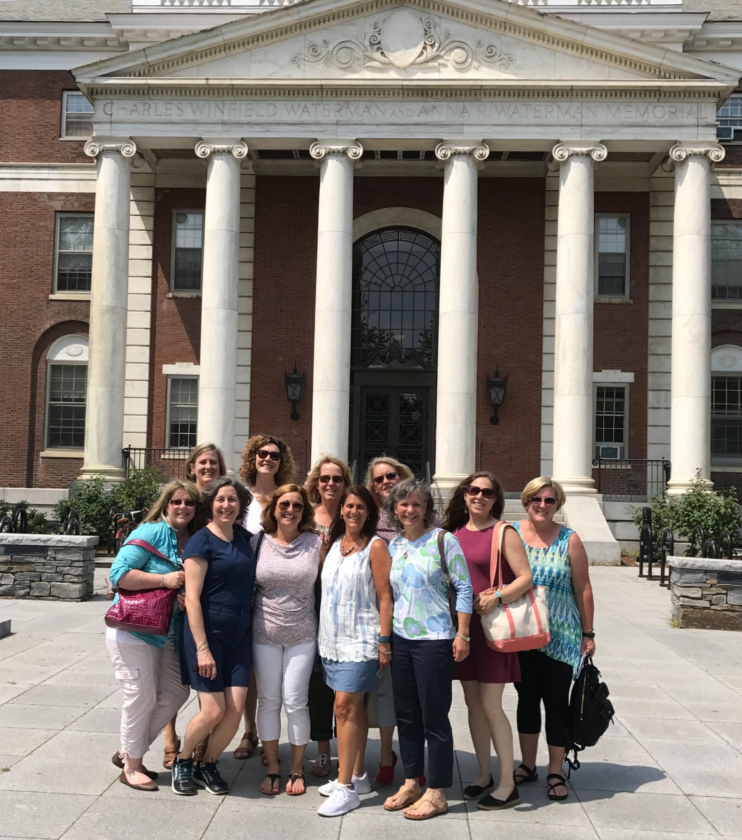
AS A VOLUNTEER YOU WILL:
Serve in a role that aligns with your skills, talents, and interests
Create connections with other volunteers, alumnae, collegians and Headquarters staff that expand your network and enhance your life
Develop professional skills to be a leader in your community and your career
Unite women to learn, grow, and inspire positive change throughout their lives
Notes:
Volunteering is a great way to stay connected to Kappa – we offer opportunities for continued learning, growth, and development.
We know you’ll continue to make connections and build friendships as a Kappa volunteer.

Slide 12
ALUMNA ASSOCIATION INFORMATION
Notes:
Alumnae associations are a resource for alumnae through programming, including social events, educational opportunities, sharing Kappa-specific information and philanthropic activities.
This is a great time to have a member from the local alumnae association talk about the opportunities and benefits of joining an association.
Explain the different ways to join an alumnae association.
Demonstrate how to locate an alumnae association on the Kappa website.
Explain that an alumna may always contact the Alumna Relations Specialist in their district when looking for an alumnae association. Consider demonstrating where to find this information on the website.

Slide 13
OUR LOCAL
ALUMNAE ASSOCIATION
IS:
Notes:
Insert name, contact info, etc. on this slide here
Alumnae associations are a great place to begin your journey. In an association, you will meet Kappas of various ages and experiences from all over the United States and Canada. Finding an association near you is easy. You need only go to the Kappa website, go to the Association Locator and find an association where you will be living. If there is not an association near you, please contact alumnaeexperience@kkg.org for help in finding Kappas near you!

Slide 14
LOCAL ALUMNAE ASSOCIATION INFO
Your information here
Your information here
Your information here
Notes:
Add AA specific information here
Most alumnae associations host activities that are similar to the chapter activities you’re already used to. Associations celebrate Founders Day and participate in philanthropic and service programs within their communities. They offer social outlets and opportunities to develop new skills and network with women in the area. Many associations include subgroups like Night Owls and Career Kappas so you can spend time with sisters who have similar interests.
The local AA should share some of what they do & what members can expect by joining.

Slide 15
LETTERS “TO MYSELF”
Notes:
Ask seniors to open their new member guide to the back envelope and read the letter they wrote to themselves. If seniors did not receive a new member guide as part of their New Member Experience, skip this section.
After they have read their letter, ask them to find a partner to share one or two insights they have from reading their letter.
To Myself as a 25-Year Alumna
Ask seniors to open their new member guide to the back page and write a letter to themselves as a 25- year alumna. If seniors do not have this book, provide paper and envelope for them to write a letter to themselves.
Ask them to consider the following questions:
You’ve been a member of Kappa Kappa Gamma for 25 years. What have you learned about yourself in that time?
What have you learned about Kappa?
What are you contributing to Kappa? Give seniors time to write their letters. Before they seal their letters into envelopes, ask them to find a partner and share one or two things they hope to do with Kappa as alumnae.

Slide 16
SERVICE FOR GRADUATING SENIORS
Notes:
Conduct the Service for Graduating Seniors. The Service for Graduating Seniors can be found in the Book of Ritual for Alumnae Associations.

Slide 17
Wrap-Up
Remember to stay in touch and update your profile so we can hear about you and what you are doing!
Notes:
As an alumna, your involvement with Kappa may ebb and flow depending on what’s happening in your life, and that’s natural. Engagement with Kappa looks different for each member and may look different at different stages of your life. The most important thing to know about your alumna membership is that Kappa is here for you throughout your lifetime and we hope you will stay connected and engaged. We hope that you continue to give your time and talents to the Fraternity and always represent Kappa.
Thank everyone for their participation.

Slide 18
QUESTIONS?
Any questions,
please contact:
LOCAL ALUMNAE ASSOCIATION CONTACT INFO
Or email:
AlumnaeExperience@kappa.org
Thank you so much for attending!
Notes:
Add local AA information on who to contact to join/questions

